Slide 1
ST. FRANCIS TURIANI HOSPITAL MVOMERO - MOROGORO
PROPOSED PROJECTS FOR IMPROVING HOSPITAL QUALITY
OF SERVICES CARE PROVISION updates
DECEMBER, 2023.

Slide 2
Introduction
Turiani hospital (TH) is located in the north of Morogoro municipal in Mvomero District serving a population of 421,741 people in its catchment area which comprise the whole of Mvomero and other nearby districts which include Kilosa, Gairo, Kilindi, Chalinze and Morogoro rural.
TH plays a crucial role in providing healthcare services to a significant population in its catchment area, serving multiple districts in Tanzania. The fact that it is a Roman Catholic Christian-ow ned facility adds distinctive characteristic to its Identity .

Slide 3
Intro….Cont
The hospital's reputation in the health care industry suggests that it has been successful in delivering quality clinical and diagnostic services, patient care and treatment.
The various departments and sections, such as the Outpatient Department (OPD), Inpatient Department (IPD), Maternity wing, Operating Theatres, Laboratory, Pharmacy, Dental, Physiotherapy, Eye Clinic, Administration, and other supporting units, indicate a comprehensive range of medical services.

Slide 4
Intro….cont
The inclusion of specialized services like Dental, Physiotherapy, and Eye Clinic reflects a holistic approach to healthcare, addressing not only immediate medical needs but also aspects of preventive and rehabilitative care.
Given its history as one of the Voluntary Agency Hospitals (VAH) built in the early 1960s, it likely has a longstanding commitment to community health. The hospital's role in the Mvomero District health system further emphasizes its importance as part of the broader healthcare infrastructure

Slide 5
2. Project Overview
Turiani hospital has a number of prioritized areas that within this few months of our leadership, have been identified as being very crucial for the development of our hospital. They were supposed to be in completed and come into use even before our coming. We dont have any ground to assume that they were neglected, but they might not be in priority agenda of the previous management.
Thus as a new management we have determined to fill all the gaps that were left to us with the use of our hospital collections and ours and other farfetched resources.

Slide 6
Cont…
We enumerate here all the projects on the basis of their urgency and importance for our Hospital development and plan. The list has the following projects:
Hospital Walkways (this was started and about to be completed)
Theatre services
Ambulance and Admiministration cars
Human resource capacity for sourcing out medica specialist doctors
Installation of Solar power.

Slide 7
Cont…
Others Include:
Renovation of the Private Ward
Completing the Mortuary
Sustainability of Pharmacy purchasing power
Adding of Radiology services ( CT, MRI and Mobile UTS)
Renovation of ICU and Emergency departments

Slide 8
Cont…
The rest Including:
Renovation of the Private ward and ICU
Establishment of Relative House
Building of the Added Staff houses
Renovation of the old buildings (Old Pharmacy into Hostel, Frs houses and Staff houses)
Renovation of the workshop and carpentry

Slide 9
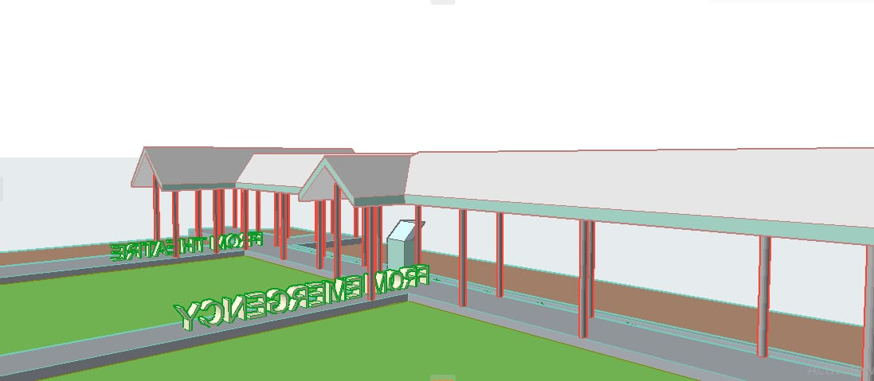
WHY THERE IS A NEED FOR THE HOSPITAL PROJECT DEVELOPMENT ON:
Walk ways:
The Covered walkways protect hospital staff, patients and other visitors from the weather as they make their way from one building and department to another. It's not always possible for patients to dash about and avoid the wind, rain or snow, making hospital walkways a really valuable addition to any hospital site.

Slide 10
Cont…
This project is already under construction and It was officially opened by Bp. Lazarus Vitalis Msimbe SDS on 21/November/2024. This is the current bishop of the catholic diocese of Morogoro and owner of the hospital.
The Project will be completed with 70 Millions from our own Collection costs.

Slide 11
WHY THERE IS A NEED FOR THE HOSPITAL PROJECT DEVELOPMENT
Our Next Priority Project is>
Operational Theatre Improvement:
Hospital handle intricate surgeries and medical procedures. Upgrading operational theaters ensures to meet modern standards, enabling better patient outcomes and reducing the risk of infections.
The hospital has three Operating Rooms. Two in the Major theatre and one in the Maternity Wings. Currently one room in Major theatre is in the use.
The problem is only, one operation can be managed and this bring under utilization of the department, we need to have a great chance to operate with more than one procidure

Slide 12
Cont….
The project can be completed if we finding the following:
Advanced Surgical Navigation sytems
Modern Operating Table
Anaesthesia Machines
Cutting edge imaging systems
Upgraded Sterilization equipments
Diathermy equipments
Different Sets for Orthopedic, Urology and ENT operations
Upgrading the theatre rooms’ equipments will commits us to provide exceptional medical care and embrancing technological advancements.

Slide 13
Cont…
The whole project will cost 658M TZS but the accomplishment will take us in phases one room after another. Find the attachment of the profoma

Slide 14
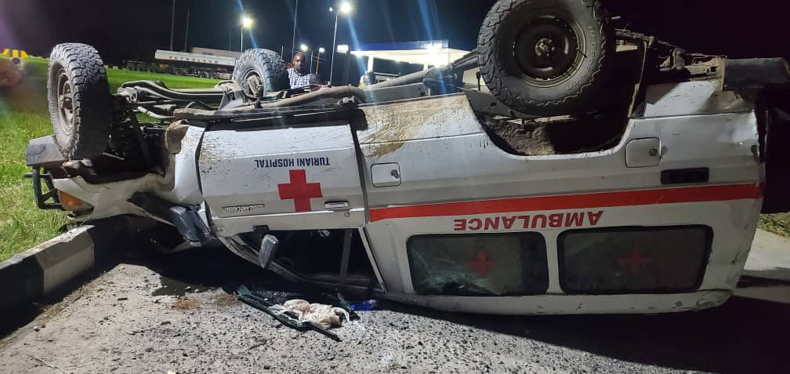
WHY THERE IS A NEED FOR THE HOSPITAL PROJECT DEVELOPMENT
Ambulance and Administration:

Slide 15
Cont..
On the evening of 28/10/2023 our ambulance got a fatal accident while escorting patient to regional hospital. Thanks God the driver came out with all people in the car safe. But the car is beyond repair. We are now looking the possibility of finding another modern ambulance.
Hospital cares patients from distant locations. Ambulances equipped with necessary medical facilities will provide timely transportation, particularly for critical cases.
Morever administration activities need a mobile car for every day running services of the hospital. Currently we have very two old cars Landcruiser and Landrover, that are maintained with recurrently maintainances,

Slide 16
Cont…
Ambulance is a typically emergency vehicle equipped to transport individuals with medical emergencies to healthcare facilities while the administration vehicle used for official purposes by organization’s officials, administrators, or employees. These vehicles are often used for transportation to and from work-related activities.
.

Slide 17
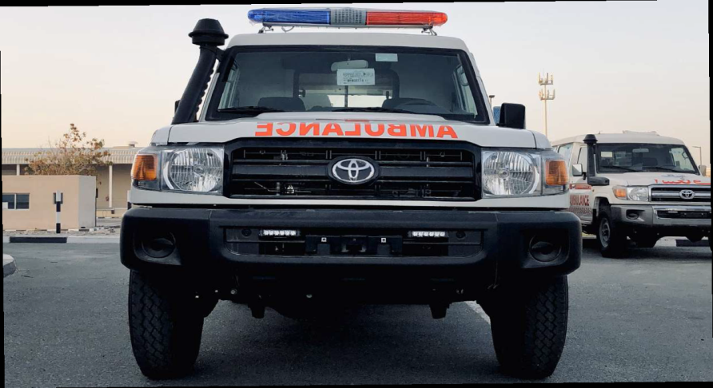
Cont…
The ambulance cost varies but with 150 Millions TZS and strong mobile car and 141Millions TZS. But this will meet with request for exemption to the revenue officer. The Diocese will help us all the process for requesting TRA exemption. On buying we will request potential donors.
Land Cruiser 78 141 Million TZS Ambulance 150M TZS

Slide 18
WHY THERE IS A NEED FOR THE HOSPITAL PROJECT DEVELOPMENT
Mortuary Building:
Hospital often deal with complex cases and fatalities. A well-equipped mortuary is essential for dignified handling of deceased patients and for forensic purposes. Currently we planned to finish the reconstruction of the present mortuary and we have estimated to cover 118 Million for the building and 100Millions for equipments.
Renovation for Administrative Block:
Efficiency in administrative operations is vital for the smooth functioning of the hospital. Renovations will enhance workspace, streamline processes, and improve overall management
Scheduled programs for the Specialists
Hospital handle intricate surgeries and medical services. Upgrading operational programs for specialists ensures to meet the specialists consultation close to our patients and thereby enabling better patient outcomes and reducing the risk of chronic and major medical cases..

Slide 19
WHY THERE IS A NEED FOR THE HOSPITAL PROJECT DEVELOPMENT
Soliciting HR Resources:
Skilled healthcare professionals are the backbone of any hospital. Recruiting qualified staff ensures quality care and allows the hospital to handle a broader spectrum of medical cases. These man power needs to be trained and improved. We are looking for potential donors who would finance the hospital with training.
Medical and Medication Equipment:
Hospital require advanced medical equipment to diagnose and treat various conditions effectively. Up-to-date equipment improves accuracy, speed, and the range of services offered. Radiology,- CT scans, MRI & potable Ultrasound are required.
Morevoer our Pharmacy need to be sustained with the enough financial capacity that can be able to buy medications and equipments whenever OS come in. Currently our pharmacy has minimize a lot of OS but on fulfilling this task we have been subjected to big pharmacys who supplies us at a fair agreement, and we return the depts. by sending the money in phase.

Slide 20
WHY THERE IS A NEED FOR THE HOSPITAL PROJECT DEVELOPMENT ON:
Patient-Centered Care:
Maternity waiting bays provide a comfortable and supportive environment for expectant mothers before delivery.
Patient's relative waiting bays offer families a space to stay close to their loved ones during treatment, promoting emotional support and involvement in care decisions.
Maternity waiting bay help manage the influx of pregnant women nearing delivery,
Patient's relative waiting bay ease congestion in patient care areas, allowing medical staff to focus on treatment.

Slide 21
WHY THERE IS A NEED FOR THE HOSPITAL PROJECT DEVELOPMENT ON:
Safety and Quality:
Upgrading drip water infusion facilities is essential for maintaining patient safety by ensuring the administration of medications and fluids is done under optimal conditions.
Renovating carpentry workshops ensures that medical equipment is maintained and repaired according to safety standards.
Enhanced Infrastructure:
Hospitals often cater to complex medical cases and emergencies. Establishing a dedicated Grade One Wing and ICU Ward ensures that the hospital will accommodate and provide specialized care for critically ill patients. This significantly enhances the hospital's capacity to handle severe cases and emergencies, potentially saving more lives.
Enhanced Medical Services: The Grade One Wing and ICU offer specialized care, improving the hospital's ability to handle critical cases effectively.

Slide 22
WHY THERE IS A NEED FOR THE HOSPITAL PROJECT DEVELOPMENT ON:
Installation of Heavy-Duty Solar Panels:
Solar panels offer a sustainable and reliable source of energy. Hospitals require uninterrupted power supply for critical medical equipment, especially in emergencies where electricity outages can be life-threatening. Using solar panels not only ensures continuous power but also reduces operational costs and environmental impact, contributing to sustainable healthcare. Currently the cost for the generator realy troubles us
Renovation of Old Buildings:
Revamping old buildings within the hospital compound serves multiple purposes. Converting the Old Pharmacy into a Hostel and repurposing priest/Chaplain houses into confortable accommodation and repairs to the staff residences helps address the shortage of space for official guests, medical staff, and support personnel.
It optimizes the hospital's infrastructure to accommodate a larger number of people efficiently.

Slide 23
Overall, these components are crucial for the following reasons:
Enhanced Medical Services:
The Grade One Wing and ICU offer specialized care, improving the hospital's ability to handle critical cases effectively.
Sustainability and Cost-Efficiency:
Solar panels provide reliable power, reduce energy costs, and contribute to environmentally friendly operations.
Training
Providing more space for patients, staff, and support services, thereby improving overall functionality and efficiency. This can be done both e learning and offiline/physical training
Investing in these developments strengthens the hospital's capabilities, making it better equipped to provide high-quality healthcare services, accommodate more patients, and create a sustainable and conducive environment for both patients and healthcare professionals.

Slide 24
Thank You & Your Welcome

